Slide 1



WELCOME TO

Slide 2

Objective of the Training
Become a Full Stack developer by gaining all the skills required to work with front-end and back-end technologies.

Slide 3

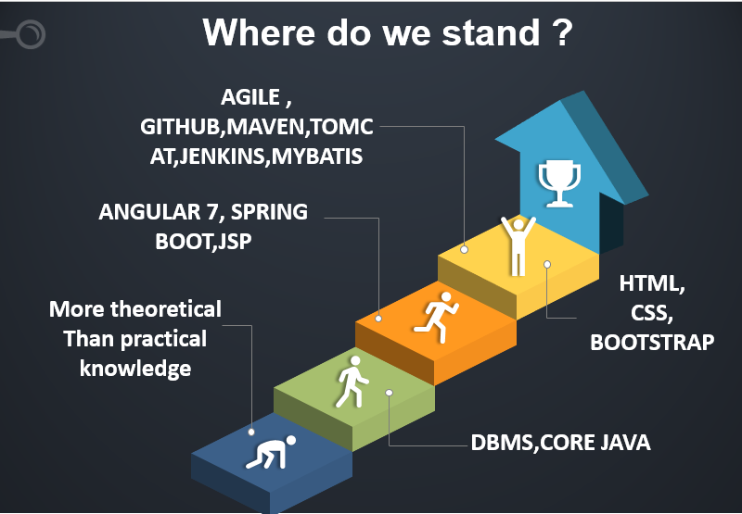

Slide 4
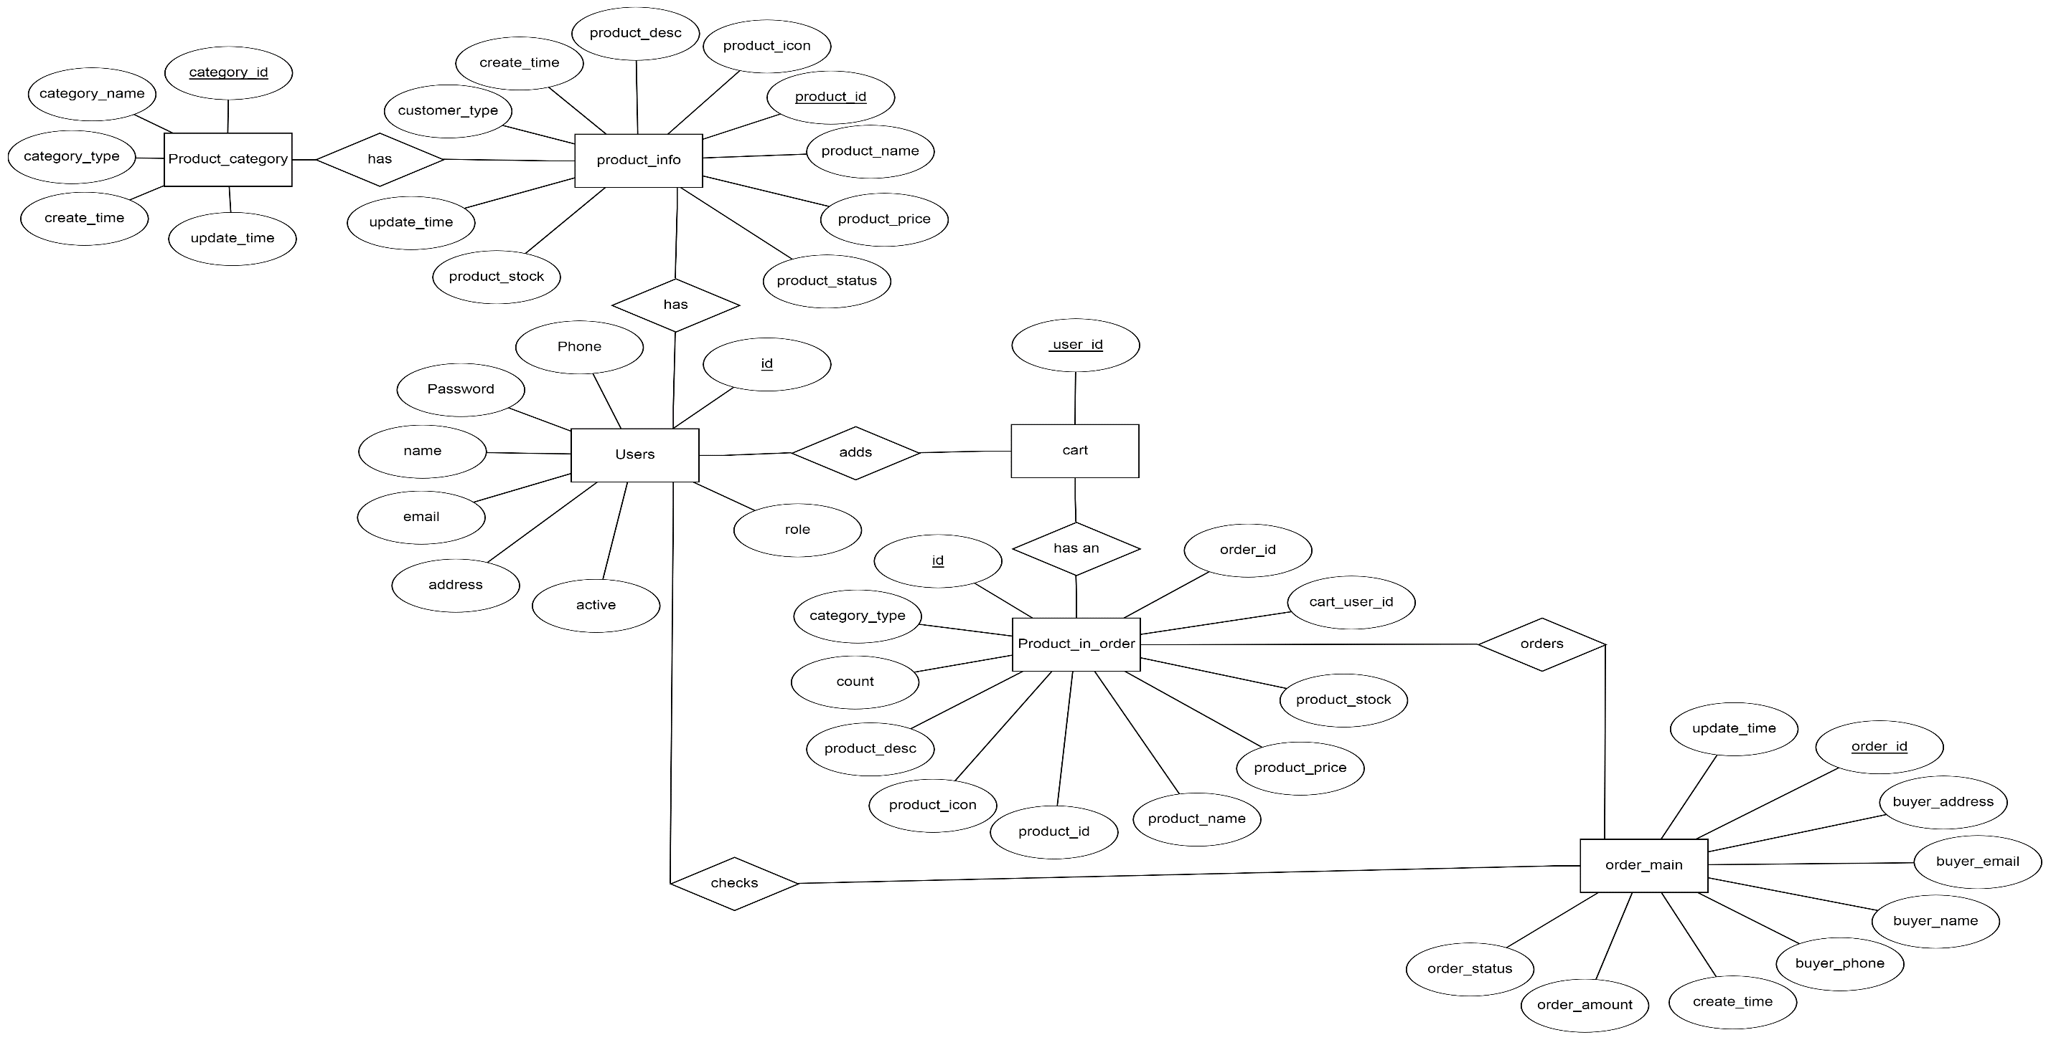
ER Diagram

Slide 5
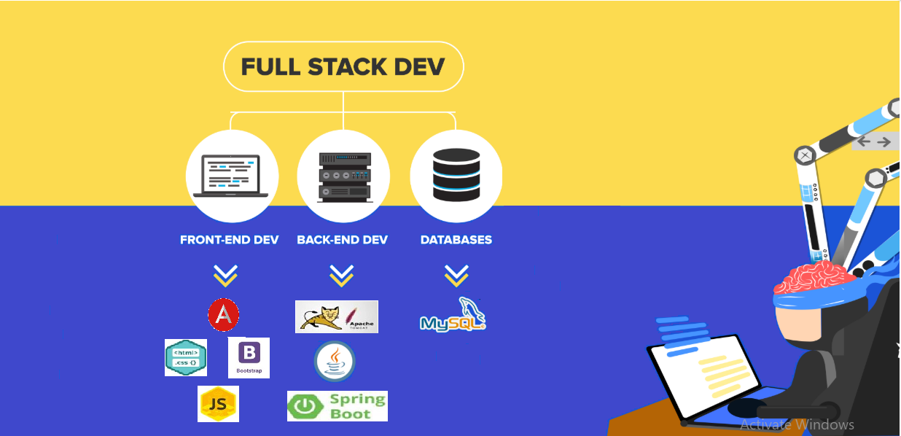

Slide 6
Project-E Commerce Web Application
E-Commerce Web Application allows us to perform all shopping related CRUDe operations.

Slide 7
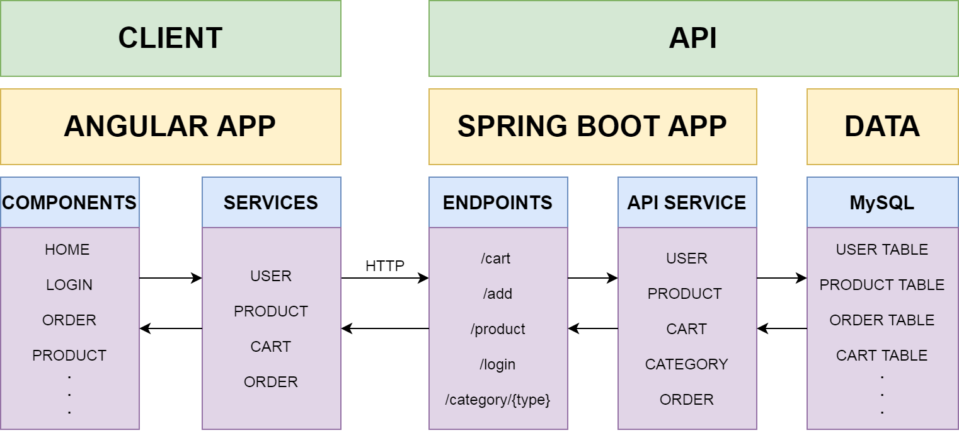
Full Stack Architecture

Slide 8
Problem Definition
To develop an interactive Ecommerce Application where one can perform Online Shopping

Slide 9

SNAPSHOTS

Slide 10
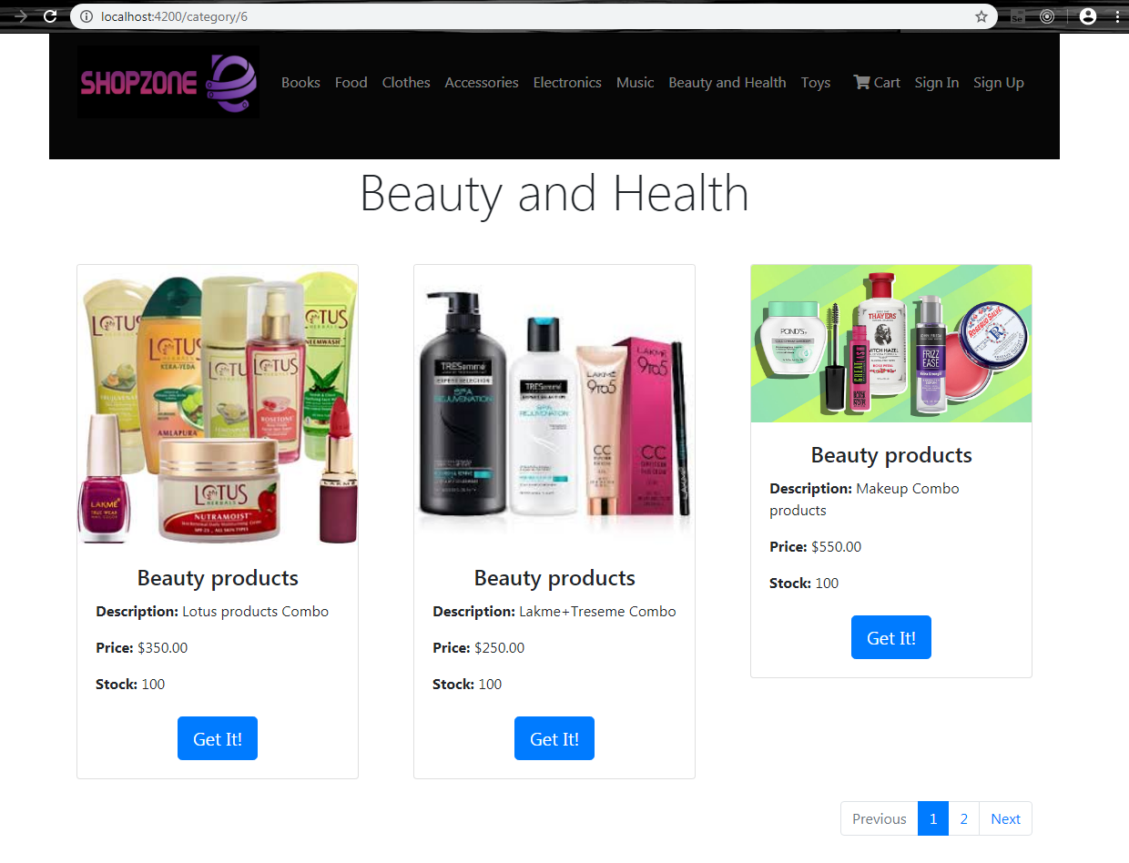
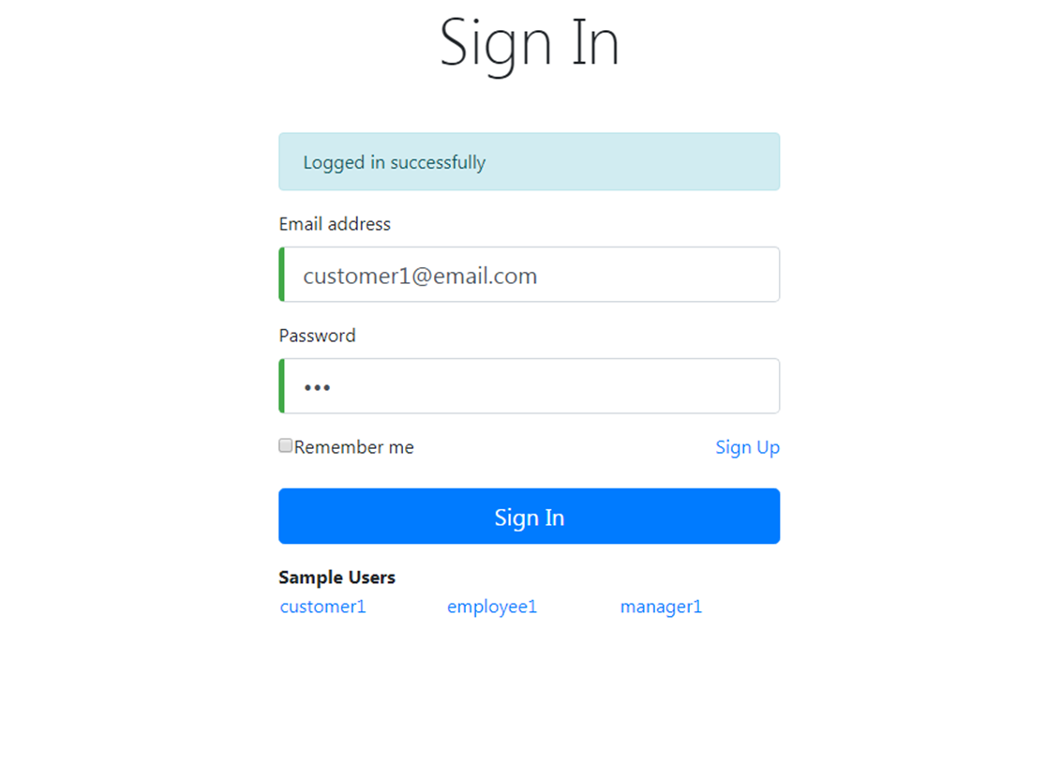

Slide 11
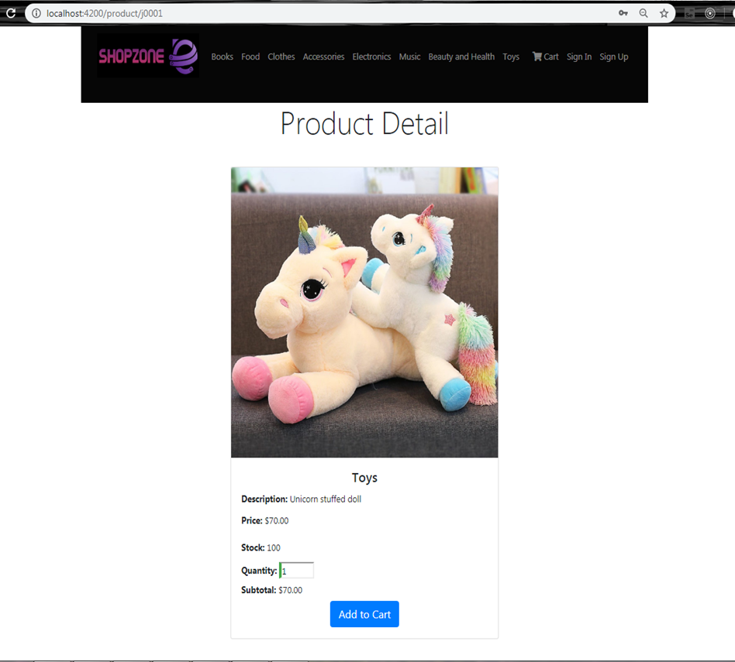
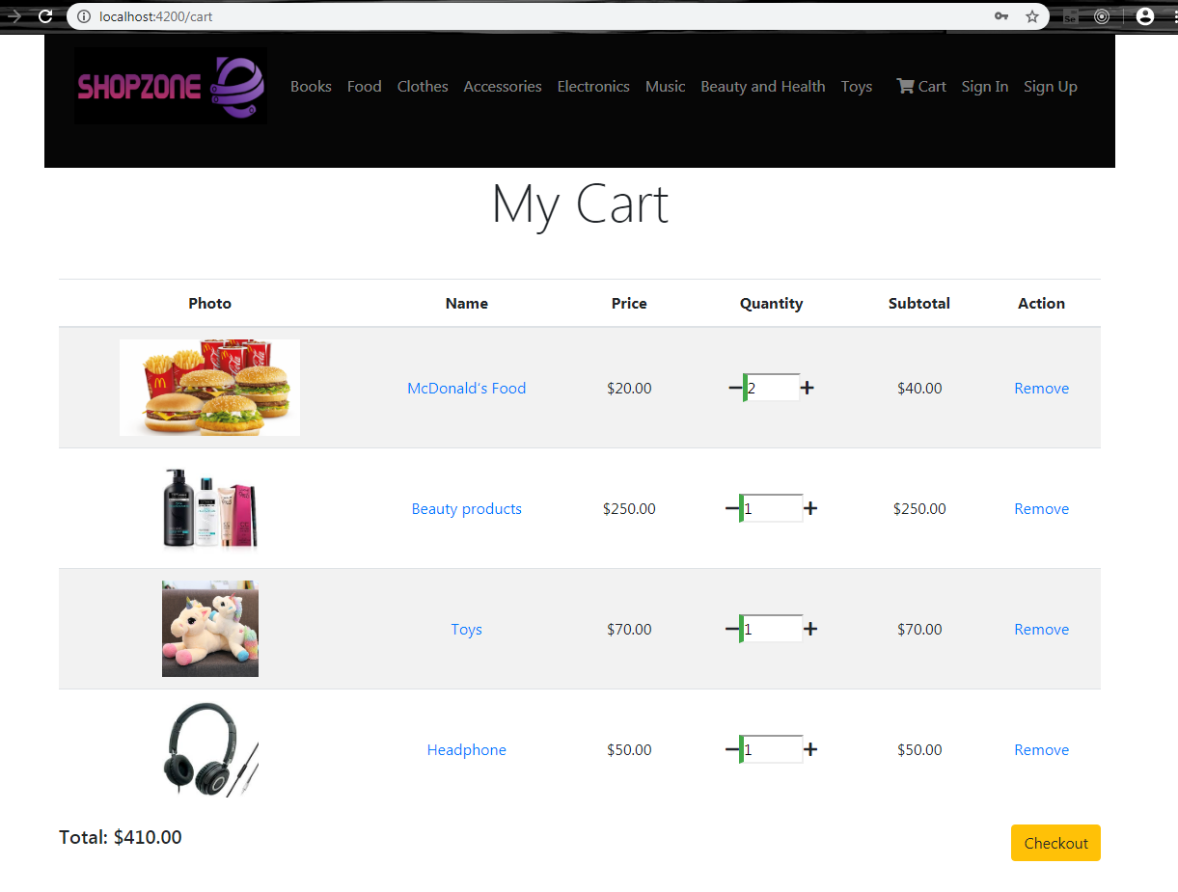

Slide 12
Scope and Conclusion
Scope
Conclusion

Slide 13

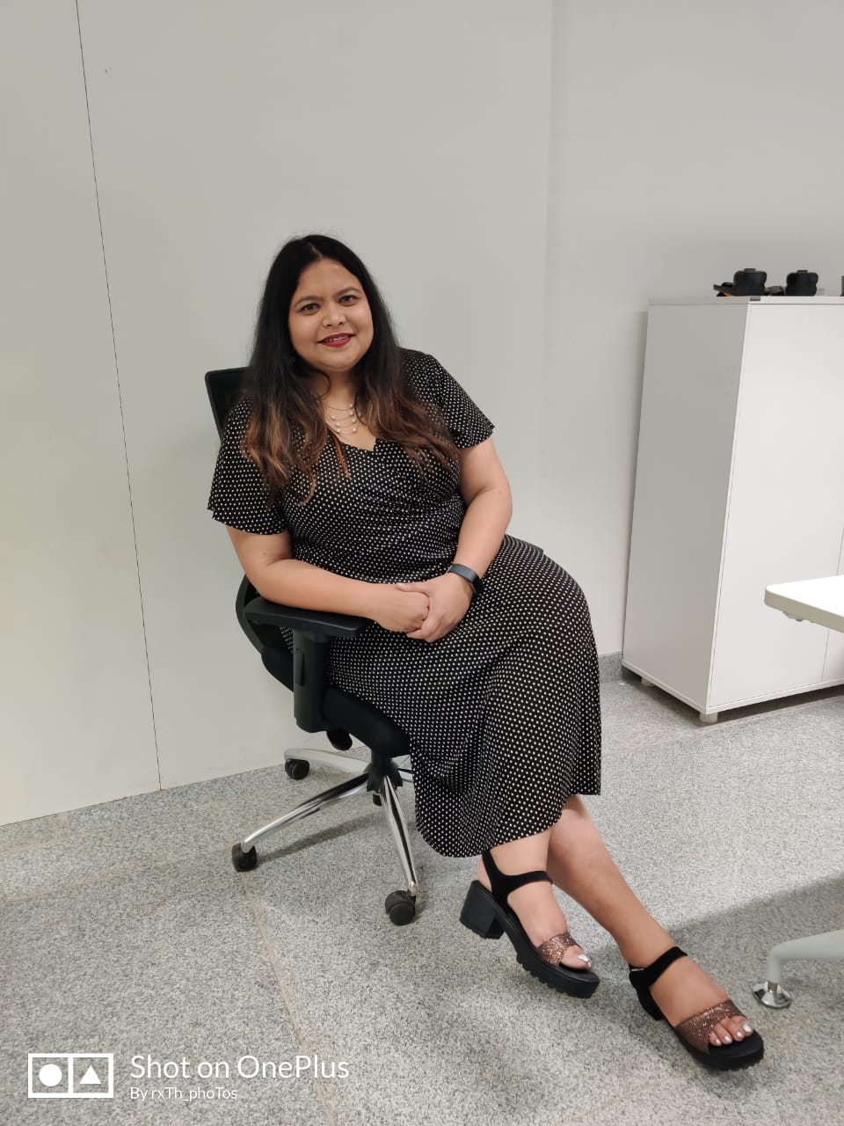
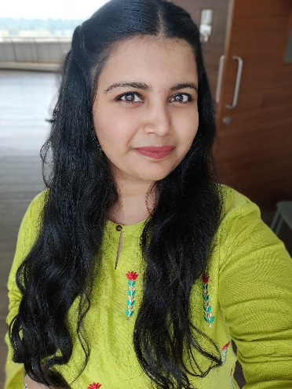
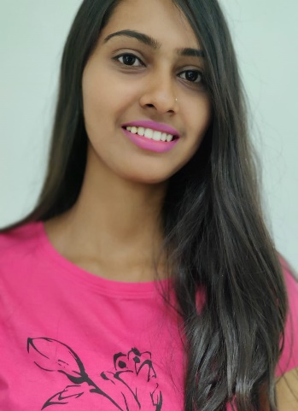
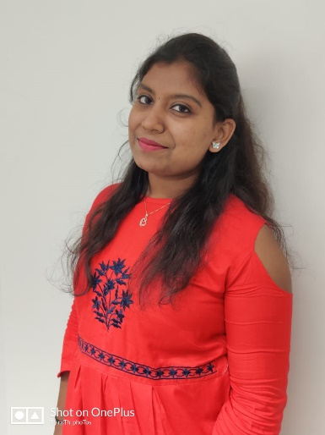
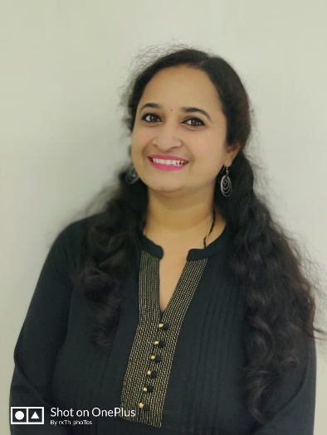
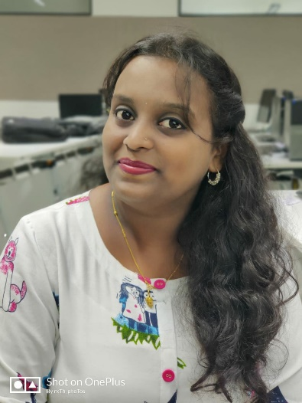
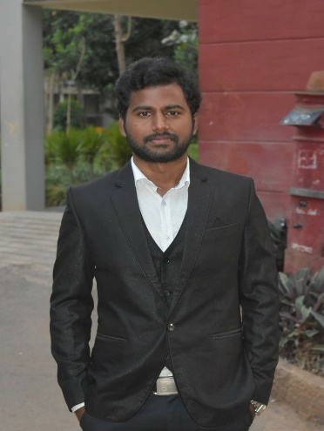
TRAINER
TEAM-IGNITE
Upasana
Rakshith
Bhyravi
Nayana
Sangeetha
Santhosh
Ramya

Slide 14

THANK YOU

Slide 15
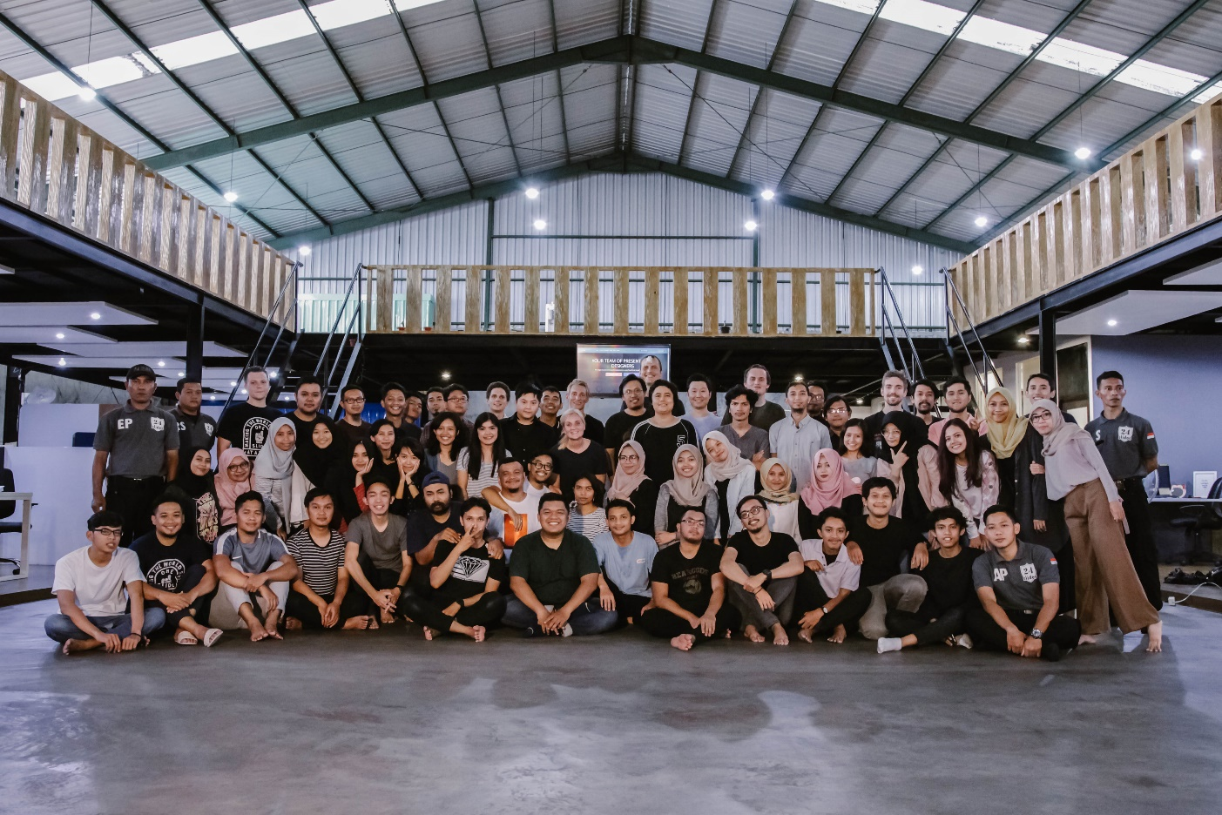
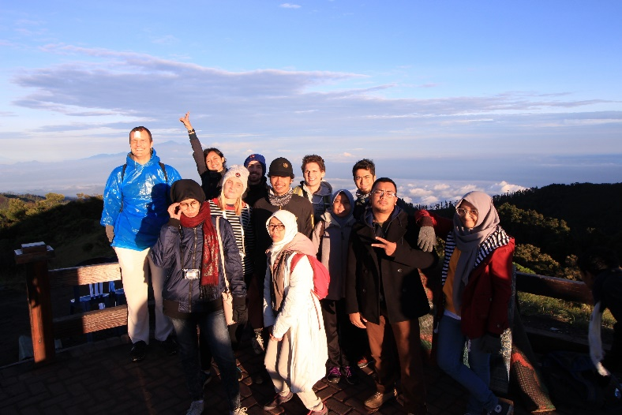
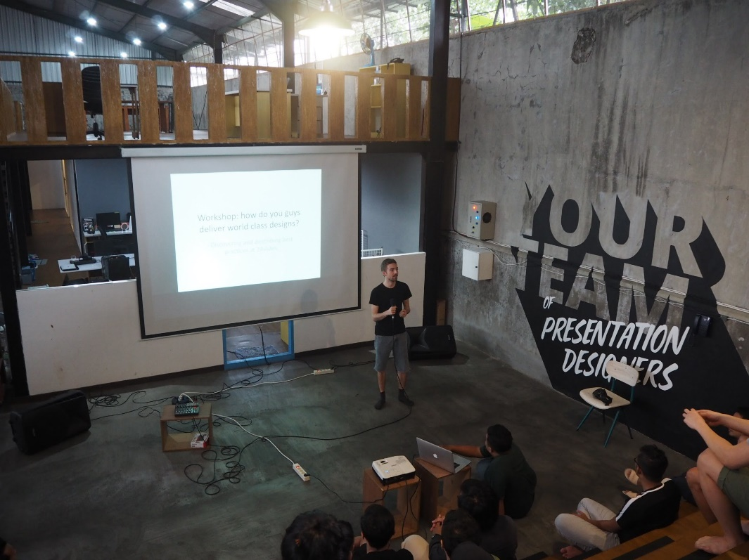
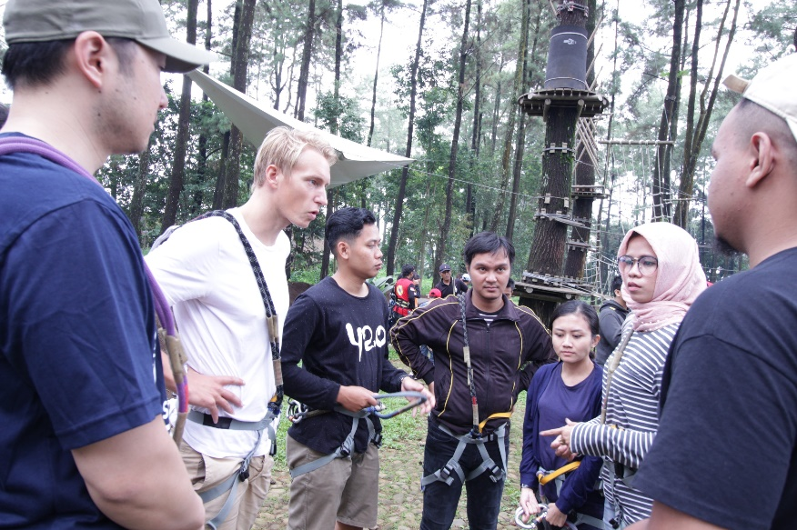
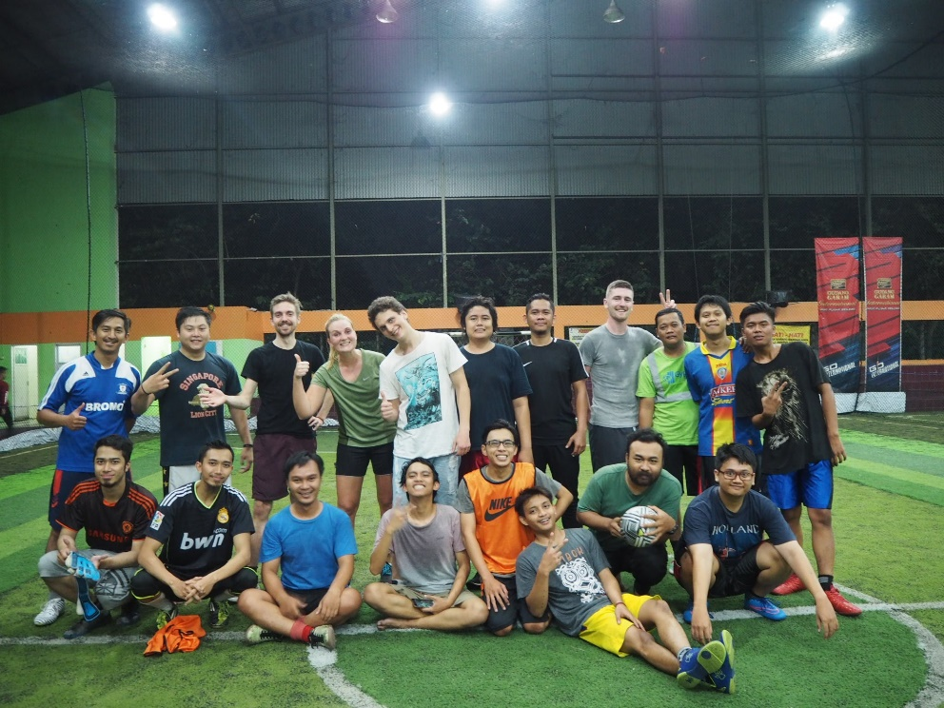
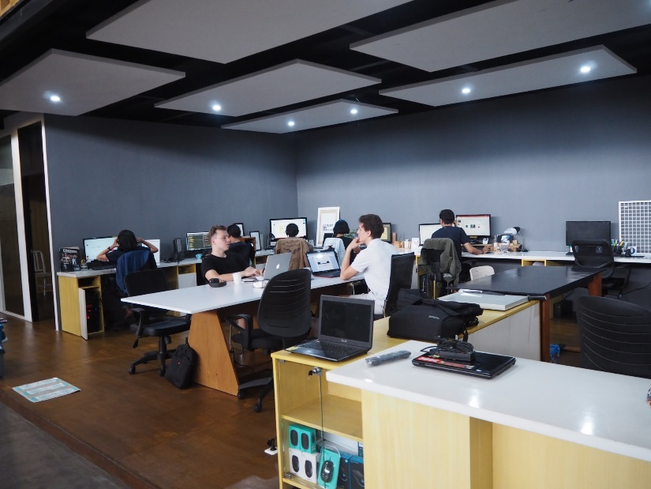

FUN AT WORK
Unlike traditional outsourcing, we want to provide extraordinary value to our customers by investing our profits into the design talent in Indonesia.
Whether it’s by educating our employees with our in house academy or by simply providing an incredible work environment with in-house gym, full health care, nutritional food and frequent social activities, we’re fully committed to empowering talents in emerging markets.
We’re leaders In redefining the traditional approach of outsourcing.

